Slide 1
चरैवेति, चरैवेति
Keep progressing to attain a higher self.
avinash.bhagat@lpu.co.in Avinash Bhagat 9463281930

Slide 2
CAP275: Data Communication and Networking
Lecture # 3
Network topologies
avinash.bhagat@lpu.co.in Avinash Bhagat 9463281930

Slide 3
Computer Network
The term ''Computer Network'' is a collection of autonomous computers interconnected by a single technology.
Two computers are said to be interconnected if they are able to exchange/share information.
Notes:
The resources which can be shared are software, hardware, and data.

Slide 4
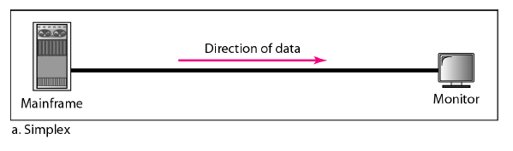
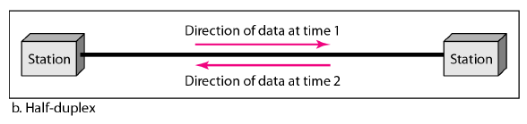
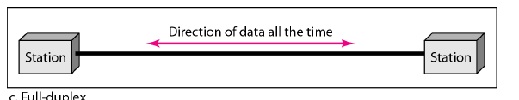
Data Flow:

Slide 5
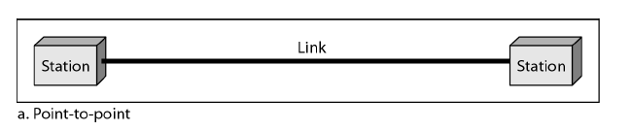
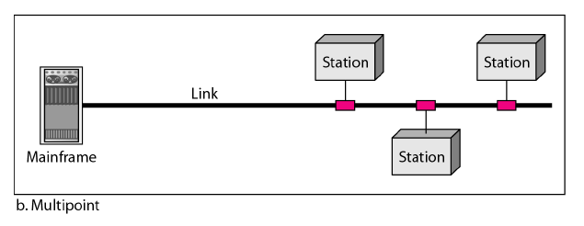
Data Flow:
Type of connection
  Point-to-Point
  Multipoint
Notes:
Point-to-Point
It provides a dedicated link between two devices. The entire capacity of the link is reserved for transmission between those two devices. e.g. When you change television channels by infrared remote control

Slide 6
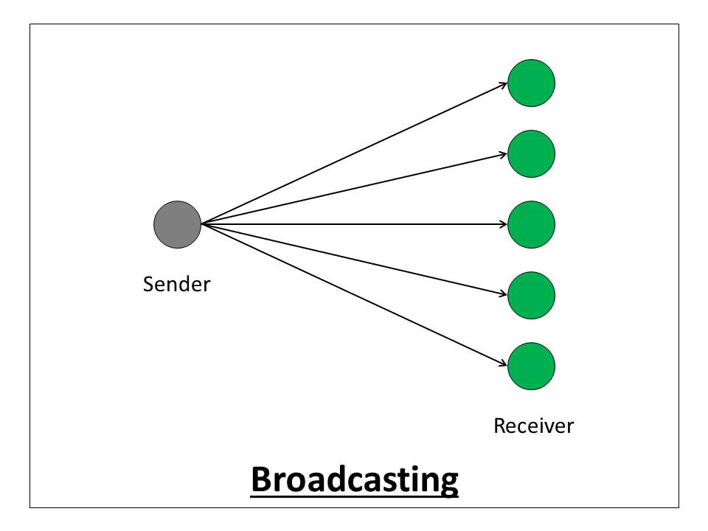
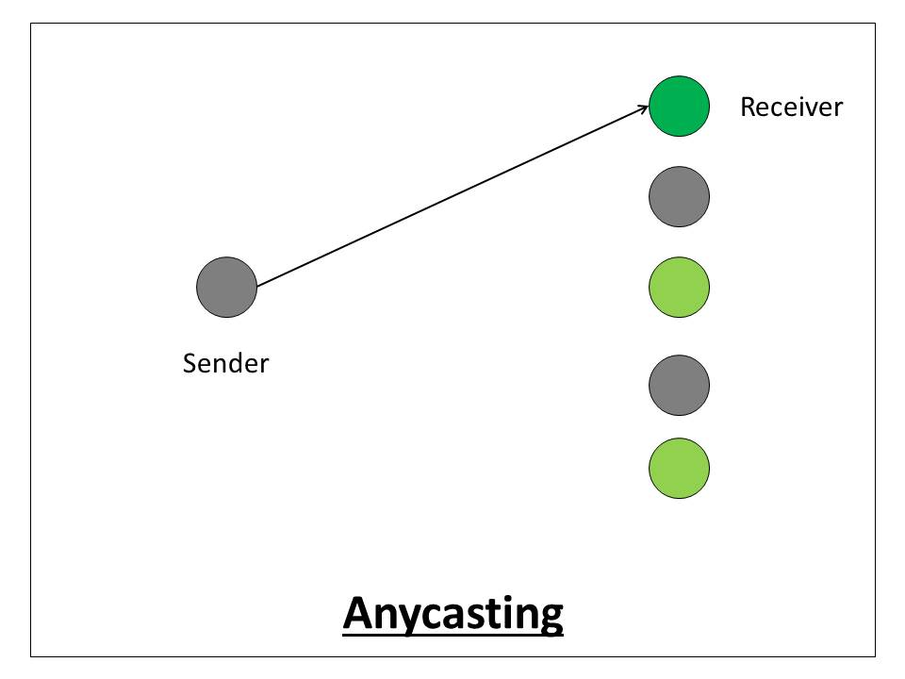
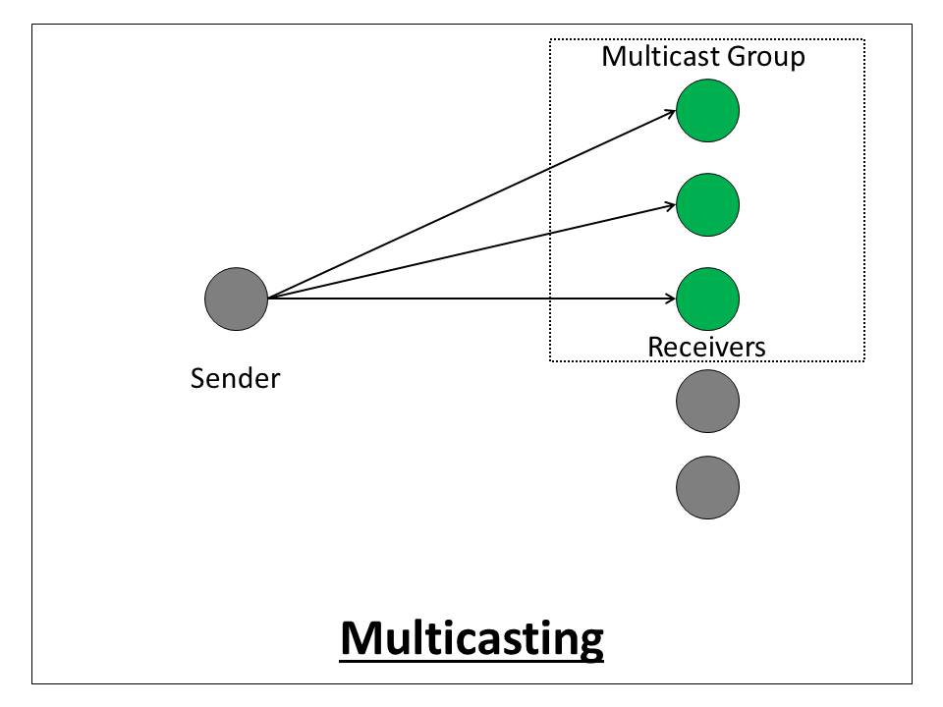
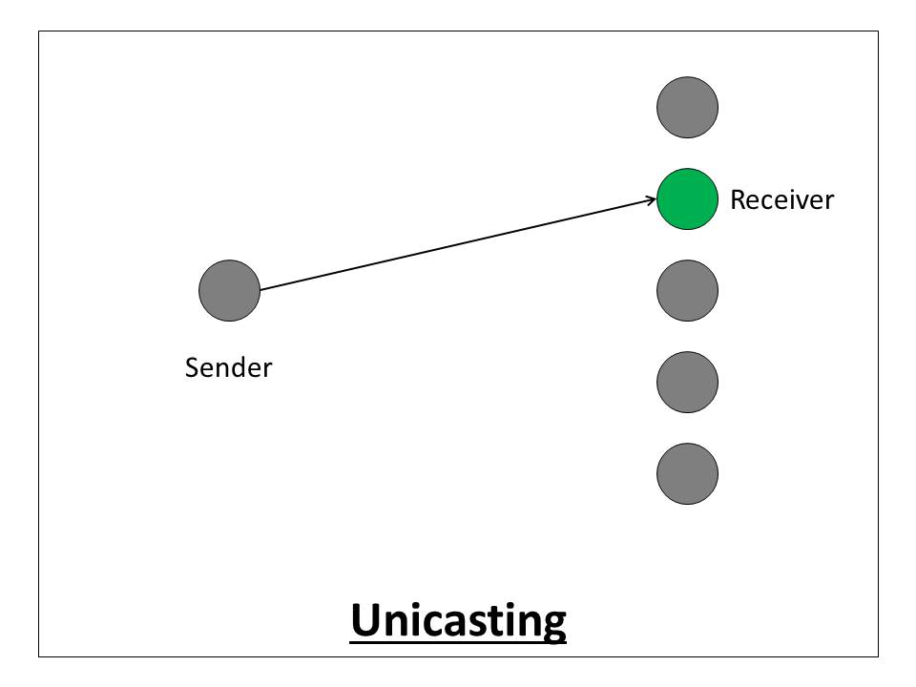
Data Flow:
Type of transmission
  Unicast
  Anycast
  Multicast
  Broadcast
Notes:
Point-to-Point
It provides a dedicated link between two devices. The entire capacity of the link is reserved for transmission between those two devices. e.g. When you change television channels by infrared remote control
Difference between unicast, multicast any cast and broadcast.
https://afteracademy.com/blog/what-is-the-difference-between-unicasting-anycasting-multicasting-and-broadcasting

Slide 7
Physical topology:
Physical Topology
The term physical topology refers to the way in which a network is laid out physically.
Two or more devices connect to a link;
Two or more links form a topology.
Notes:
The topology of a network is the geometric representation of the relationship of all the links and linking devices to one another.

Slide 8
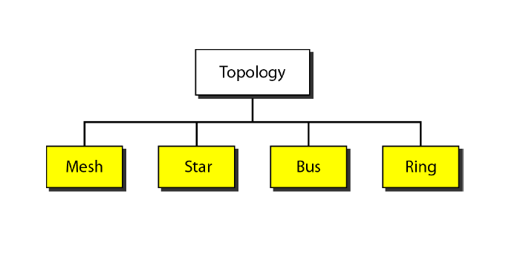
Physical topology:

Slide 9
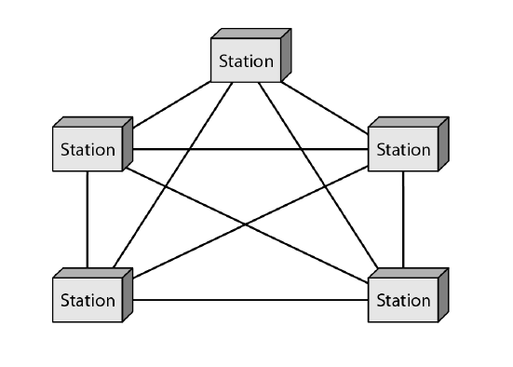
Mesh topology:
Number of physical links in a fully connected mesh network with n nodes,
N = n(n-1)/2
Notes:
Every device has a dedicated point-to-point link to every other device. The term dedicated means that the link carries traffic only between the two devices it connects.
Advantages of Mesh Topology
The use of dedicated links guarantees that each connection can carry its own data load thus eliminating traffic problems.
Mesh topology is robust. If one link becomes unusable, it does not incapacitate the entire system.
Privacy or security. When every message travels along a dedicated line, only the intended recipient sees it. Physical boundaries prevent other users from gaining access to messages.
Point-to-point links make fault identification and fault isolation easy. Traffic can be routed to avoid
links with suspected problems. This facility enables the network manager to discover the precise location of the fault and aids in finding its cause and solution.

Slide 10
Mesh topology:
Advantages of Mesh Topology
Eliminating traffic problems.
Robust.
Privacy or security.
fault identification and fault isolation easy.
Notes:
Every device has a dedicated point-to-point link to every other device. The term dedicated means that the link carries traffic only between the two devices it connects.
Advantages of Mesh Topology
The use of dedicated links guarantees that each connection can carry its own data load thus eliminating traffic problems.
Mesh topology is robust. If one link becomes unusable, it does not incapacitate the entire system.
Privacy or security. When every message travels along a dedicated line, only the intended recipient sees it. Physical boundaries prevent other users from gaining access to messages.
Point-to-point links make fault identification and fault isolation easy. Traffic can be routed to avoid
links with suspected problems. This facility enables the network manager to discover the precise location of the fault and aids in finding its cause and solution.

Slide 11
Mesh topology:
Disadvantages of Mesh Topology
Amount of cabling
Number of I/O ports.
installation and reconnection are difficult.
Infrastructure problem for big networks.
Expensive hardware.
Notes:
amount of cabling and
the number of I/O ports required.
Because every device must be connected to every other device, installation and reconnection are difficult.
Bulk of the wiring can be greater than the available space (in walls, ceilings, or floors) can accommodate.
The hardware required to connect each link (I/O ports and cable) can be prohibitively expensive.

Slide 12
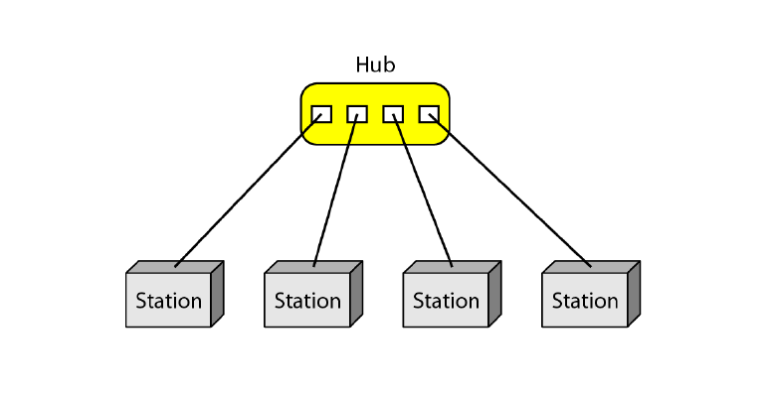
Star Topology
* Mesh and Star topologies were examples of point to point communication.
Notes:
In a star topology, each device has a dedicated point-to-point link only to a central controller, usually called a hub.
The devices are not directly linked to one another.
Unlike a mesh topology, a star topology does not allow direct traffic between devices.
The controller acts as an exchange: If one device wants to send data to another, it sends the data to the controller, which then relays the data to the other connected device .

Slide 13
Star topology:
Advantages of star Topology
Less expensive .
Easy installation.
Scalability.
Robustness.
Easy fault identification and fault isolation.
Notes:
A star topology is less expensive than a mesh topology.
In a star, each device needs only one link and one I/O port to connect it to any number of others.
This factor also makes it easy to install and reconfigure.
Far less cabling needs to be housed.
Additions, moves, and deletions involve only one connection: between that device and the hub.
Robustness. If one link fails, only that link is affected all other links remain active.
This factor also lends itself to easy fault identification and fault isolation. As long as the hub is working, it can be used to monitor link problems and bypass defective links.

Slide 14
Star topology:
Disadvantages of star Topology
Dependency on one single point,.
more cabling is required (than ring or bus).
Notes:
Dependency of the whole topology on one single point, the hub. If the hub goes down, the whole system is dead.
Although a star requires far less cable than a mesh, each node must be linked to a
central hub. Often more cabling is required in a star than in some other topologies (such as ring or bus).

Slide 15
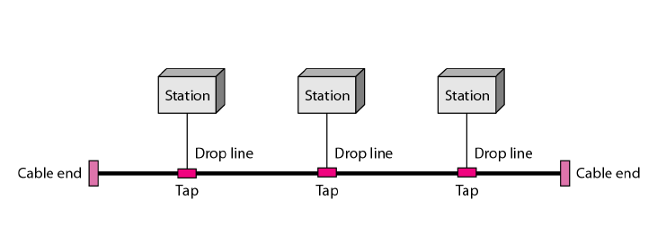
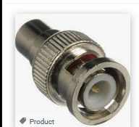
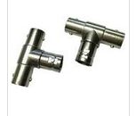
Bus Topology
* Mesh and Star topologies were examples of point to point communication.
* A bus topology, on the other hand, is multipoint
Notes:
Nodes are connected to the bus cable by drop lines and taps.
A drop line is a connection running between the device and the main cable.
A tap is a connector that punctures the sheathing of a cable to create a contact with the metallic core.
As a signal travels along the backbone, some of its energy is transformed into heat. Therefore, it becomes weaker and weaker as it travels farther and farther. For
this reason there is a limit on the number of taps a bus can support and on the distance between those taps.

Slide 16
Bus topology:
Advantages of Bus Topology
Ease of installation..
Uses less cabling than mesh or star topologies.
Notes:
Ease of installation. Backbone cable can be laid along the most efficient path, then connected to the nodes by drop lines of various
lengths.
A bus uses less cabling than mesh or star topologies. For example, four network devices in the same room require four lengths of cable reaching.

Slide 17
Bus topology:
Disadvantages of Bus Topology
Difficult fault isolation,.
Difficult to add new devices.
Signal reflection at the taps can cause degradation in quality.
Notes:
Difficult reconnection and fault isolation. A bus is usually designed to be optimally efficient at installation.
Adding new devices require modification or replacement of the backbone.

Slide 18
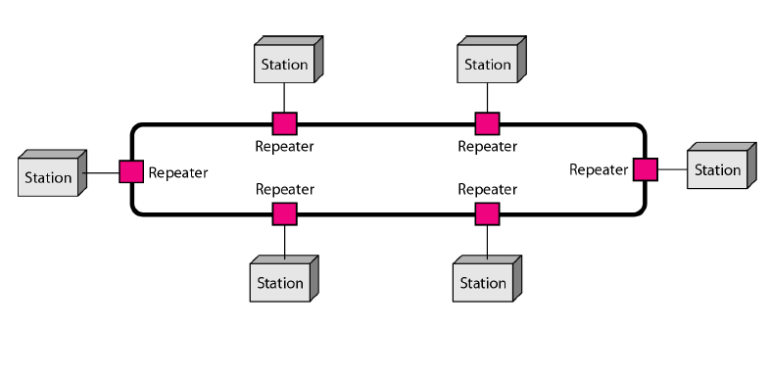
Ring Topology
Notes:
Each device has a dedicated point-to-point connection with only the two devices on either side of it.
A signal is passed along the ring in one direction, from device to device, until it reaches its destination.
Each device in the ring incorporates a repeater.
When a device receives a signal intended for another device, its repeater regenerates the bits and passes them along

Slide 19
Ring topology:
Advantages of Ring Topology
Easy to install and reconfigure.
Scalable.
Ease of fault isolation
Notes:
A ring is relatively easy to install and reconfigure. Each device is linked to only its immediate neighbors (either physically or logically).
To add or delete a device requires changing only two connections. The only constraints are media and traffic considerations (maximum ring length and number of devices).
Fault isolation is simplified.
Generally in a ring, a signal is circulating at all times. If one device does not receive a signal within a specified period, it can issue an alarm. The alarm alerts the network operator to the problem and its location.
.

Slide 20
Ring topology:
Disadvantages of ring Topology
In a simple ring, a break in the ring (such as a disabled station) can disable the entire network
Difficult to add new devices.
Signal reflection at the taps can cause degradation in quality.
Notes:
Due to unidirectional traffic in a simple ring, a break in the ring (such as a disabled station) can disable the entire network. This weakness can be solved by using a dual ring or a switch capable of closing off the break..

Slide 21
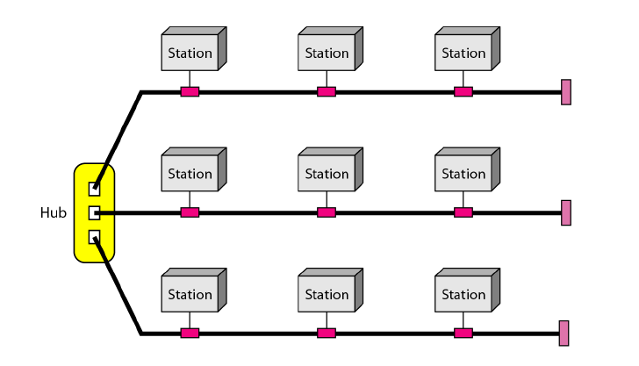
Hybrid Topology
Notes:
A network can be hybrid. For example, we can have a main star topology with each branch connecting several stations in a bus topology as shown in Figure

Slide 22
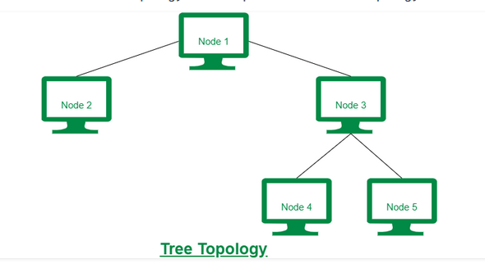
Hierarchical or tree Topology

Slide 23
Subjective Questions
Q1 Explain working of Mesh topology ? What are its advantages and disadvantages of Mesh topology and where can we use it ? 10 marks
Q2 Explain working of Star topology ? What are its advantages and disadvantages and where can we use it ? 10 marks
Q3 Explain working of BUS topology ? What are its advantages and disadvantages and where can we use it ? 10 marks
Q4 Explain working of Ring topology ? What are its advantages and disadvantages and where can we use it ? 10 marks
Q5 Define computer networks? Discuss various types of networks topologies in computer network. Also discuss various advantages and disadvantages of each topology.

Slide 24
Multiple Choice Questions
Which topology requires a central controller or hub?
a. Mesh
b. Star
c. Bus
d. Ring
Which topology requires a multipoint connection?
a. Mesh
b. Star
c. Bus
d. Ring
A _______ connection provides a dedicated link between two devices.
a. point-to-point
b. multipoint
c. primary
d. secondary

Slide 25
Multiple Choice Questions
Which topology requires a central controller or hub?
a. Mesh
b. Star
c. Bus
d. Ring
Which topology requires a multipoint connection?
a. Mesh
b. Star
c. Bus
d. Ring
: A _______ connection provides a dedicated link between two devices.
a. point-to-point
b. multipoint
c. primary
d. secondary

Slide 26
Multiple Choice Questions
In a _______ connection, more than two devices can share a single link.
a. point-to-point
b. multipoint
c. primary
d. Secondary
Which topology requires a multipoint connection?
a. Mesh
b. Star
c. Bus
d. Ring

Slide 27
Multiple Choice Questions
In a _______ connection, more than two devices can share a single link.
a. point-to-point
b. multipoint
c. primary
d. Secondary
Which topology requires a multipoint connection?
a. Mesh
b. Star
c. Bus
d. Ring

Slide 28


See you in next class

